Slide 1
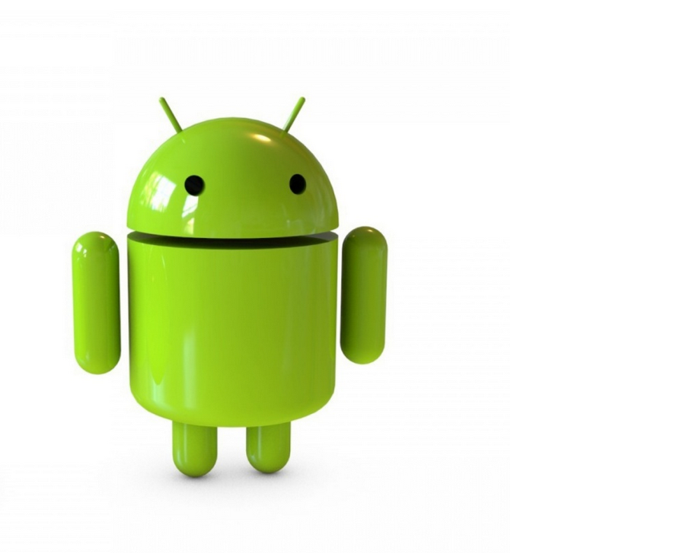
LATE.ly

Slide 2
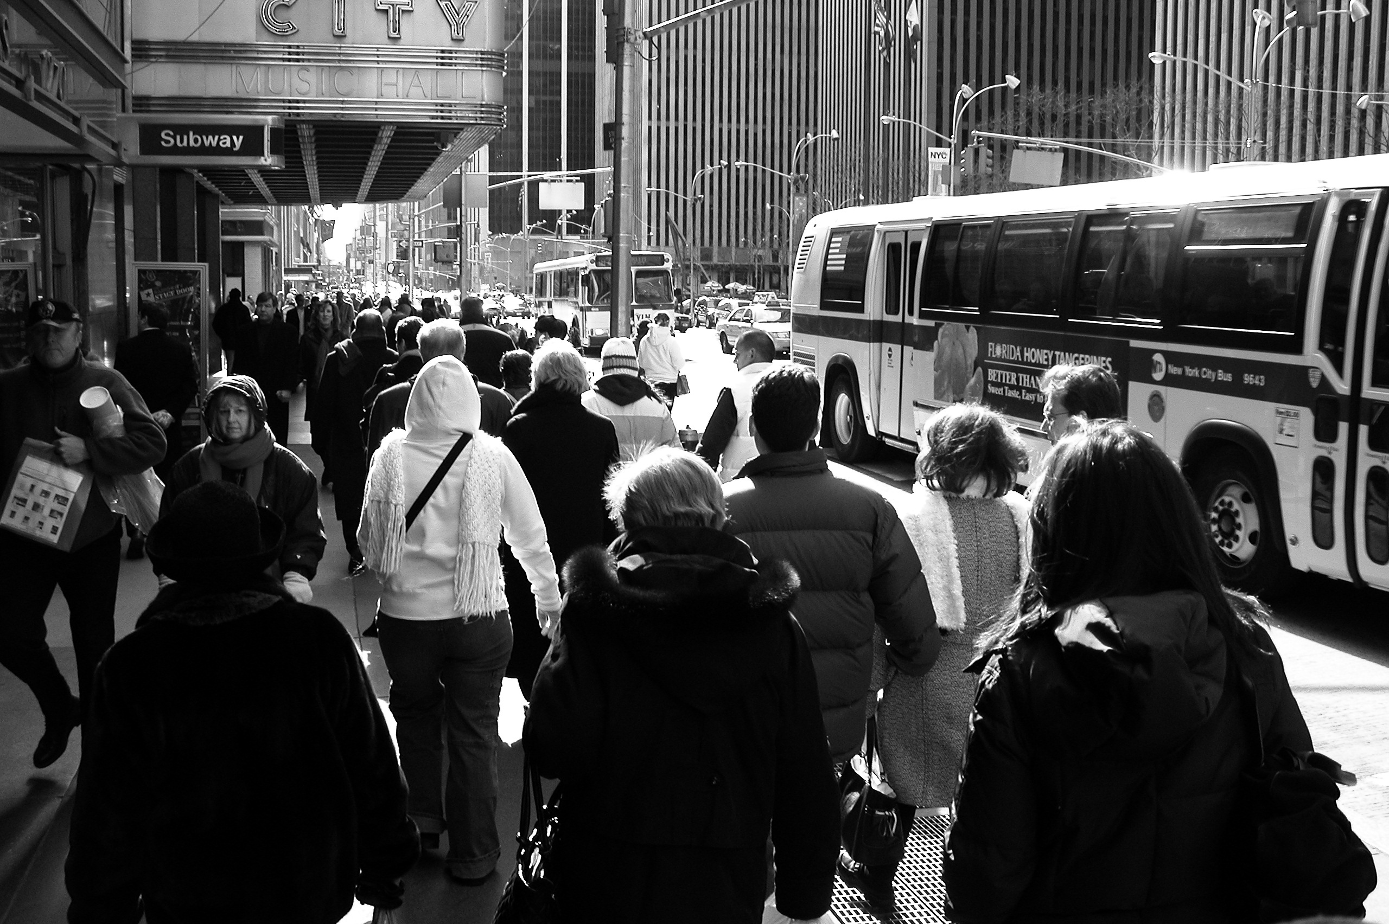

Slide 3
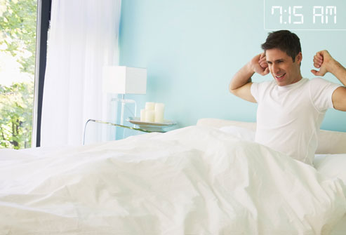
Good morning!

Slide 4
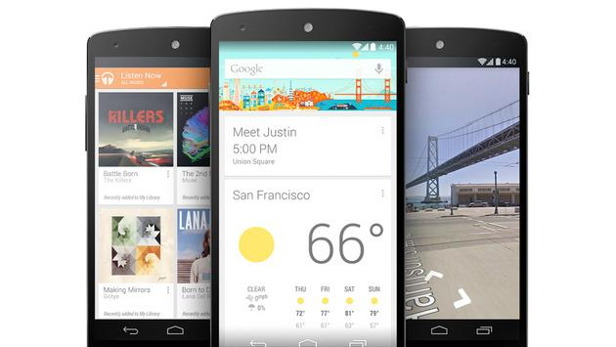
Our app integrate the simplicity of design while still retaining the complexities

Slide 5
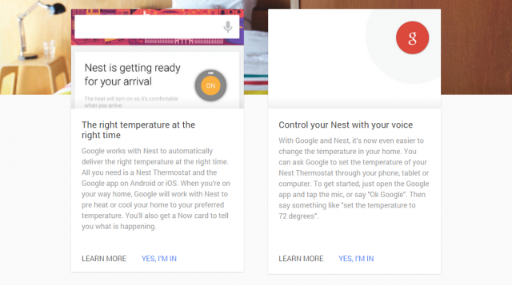
Information at a glance. Soft and pleasant user experience.

Slide 6

Social Interactions!
You’ll want to share with friends.

Slide 7


Slide 8








High value at no cost to users!

Slide 9
LATE.LY

